Slide 1
R-TPI: A NOVEL DESIGN FOR ACCELERATING DOSE FINDING TRIALS
Wentian Guo
Laiya Consulting, Inc
Shanghai Biostatistics Forum, Dec 2018

Slide 2
R-TPI: Rolling Toxicity Probability Interval Design to
Shorten the Duration and Maintain Safety of Phase I Trials
Accepted by Journal of Biopharmaceutical Statistics
Joint work by Wentian Guo¹, Yuan Ji^{1,2}, and Daniel Li³
1: Laiya Consulting, Inc., USA
2: University of Chicago, USA
3: Juno Therapeutics, USA

Slide 3

天下武功
唯快不破
SPEED TRUMPS EVERYTHING IN KUNG FU FIGHTING

Slide 4
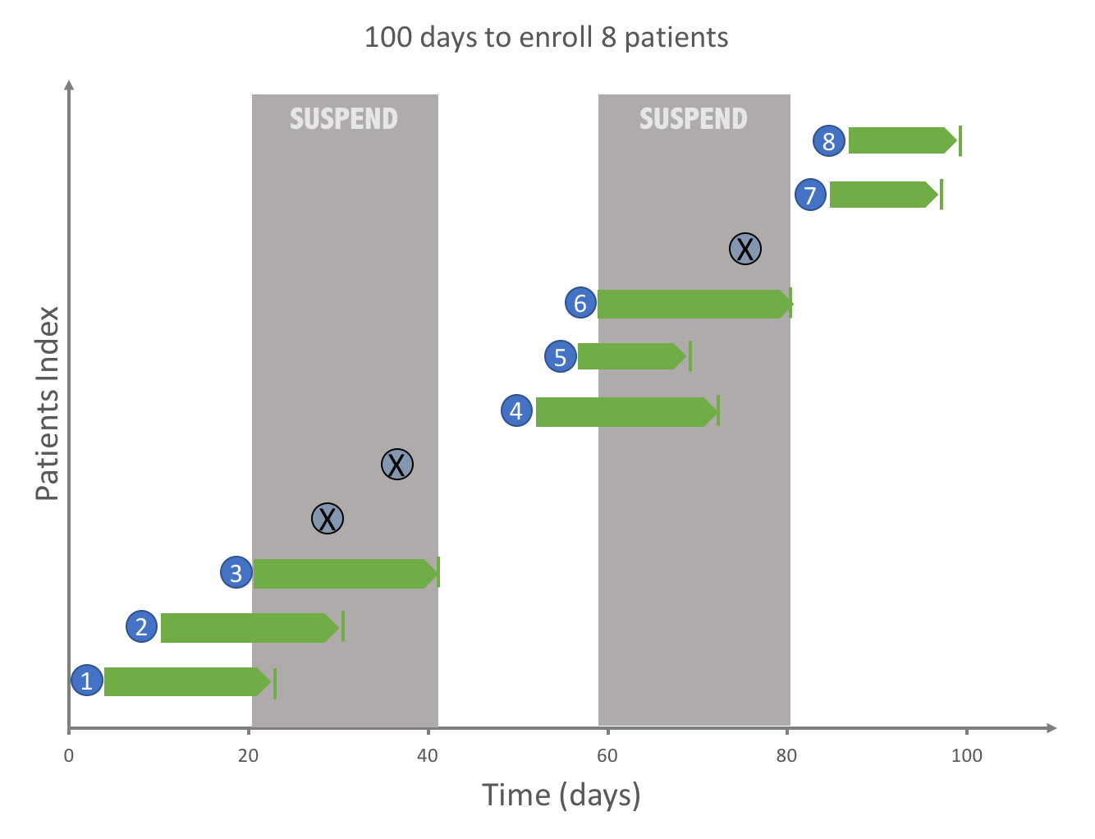
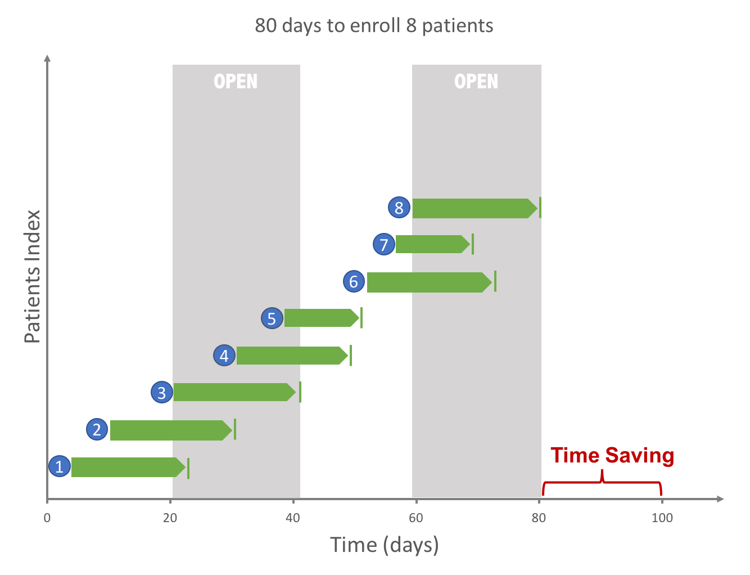
Cohort-Based vs Rolling Dose Finding Designs
Cohort-Based
3+3, mTPI-2, mTPI, CRM, BLRM
Patient enrollment is suspended between cohorts
Rolling
Ideally few suspensions
: 20 days
Timeline for a trial based on 3+3
(DLT assessment window is 21 days)
Timeline for a rolling trial

Slide 5
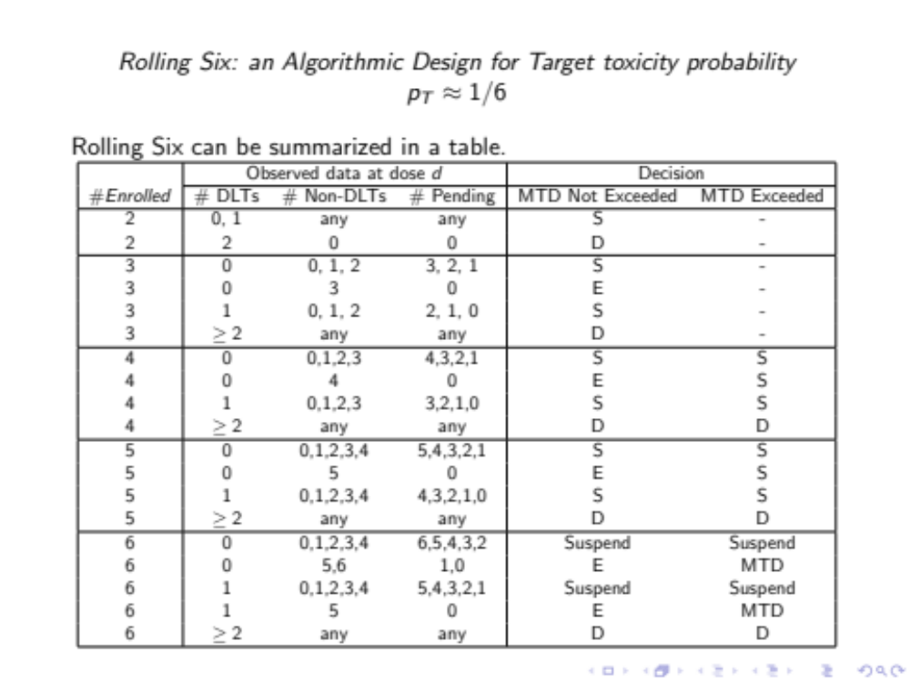
The Rolling Six Design (RSD)
Skolnik et al., 2008, JCO
Extension of 3+3
How? Use the incomplete data for dosing decisions.

Slide 6
The Rolling Six Design (RSD)
Skolnik et al., 2008, JCO
Extension of 3+3
How? Use the incomplete data for dosing decisions.
Debatable decisions:
0 DLT, 0 Non-DLT, 3 pending: S
Somewhat aggressive
0 DLT, 3 Non-DLTs, 1 pending: S
    Waste patient resources at low doses

Slide 7
The Rolling Six Design (RSD)
Skolnik et al., 2008, JCO
Extension of 3+3
How? Use the incomplete data for dosing decisions.
Debatable decisions:
0 DLT, 0 Non-DLT, 3 pending: S
Somewhat aggressive
0 DLT, 3 Non-DLTs, 1 pending: S
Waste patient resources at low doses

Slide 8
The Rolling Six Design (RSD)
Skolnik et al., 2008, JCO
Extension of 3+3
How? Use the incomplete data for dosing decisions.
Debatable decisions:
0 DLT, 0 Non-DLT, 3 pending: S
Somewhat aggressive
0 DLT, 3 Non-DLTs, 1 pending: S
Waste patient resources at low doses
Other problems (3+3)
rule-based and by definition, cannot adjust to different pT values
only rules for up to six patients

Slide 9
R-TPI is a hybrid design
mTPI-2
A simple cohort-based design superior to 3+3
Bayesian Inference
Ability to target different toxicity probabilities
Decisions for more than six patients
R-TPI
Rolling Six
Fast Rolling Enrollment algorithm

Slide 10
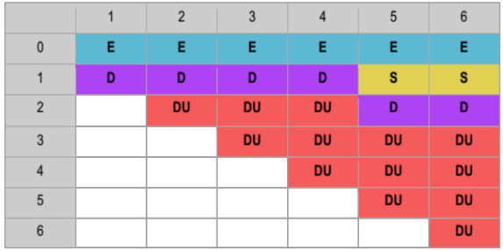
Motivating Example
Consider a given moment of a mTPI-2 driven trial: 3 patients at the current dose d, including
  n_{d}=2 (# of outcomes),
        y_{d}=1 (# of DLT);
  m_{d}=1 (# of pending patients).
mTPI-2 Decision Table (pT=0.17)
Column indicates the number of patients treated.
Row indicates the number of patients with DLTs
What if a new patient becomes eligible?
  Under mTPI-2, turn the new patient away and open enrollment after observing the outcome of the third patient.
Any BETTER idea?
Regardless of what outcome of the pending patient is, the decision is D.

Slide 11
R-TPI Overview
Two stages in R-TPI
  Run-in stage: when a dose is never tested before
  Rolling stage: after run-in stage when some data accumulate

Slide 12
Rules for a Dose Never Used: Run-in Stage
Run-in stage
  For dose d₀ never used, R-TPI keeps enrolling new patients at d₀ until either
  n_{d0} = 0 and m_{d0} = C , e.g., C = 3, or
  n_{d0} > 0 , i.e. there is at least one outcome at d₀ .
  If condition 2 is met, switch to rolling stage.
  Else, wait until n_{d0} > 0 and then switch to rolling stage.
C is the maximum number of pending patients allowed in the trial.
The larger C is, the faster the trial is
  But may expose many patients on unsafe or low doses if enrollment speed is high

Slide 13
Rolling Stage
Rolling stage: after run-in we have at least one observation at current dose d.
  Whenever a new patient becomes eligible:
    If m_{d}=0, assign the new patient based on D(y_{d},n_{d});
    If m_{d}=C, suspend the enrollment;
    Otherwise, assign the new patient based on R-TPI decision rules

Slide 14
Rolling Stage: R-TPI Decision Rules
 | D(y_{d},n_{d}) | D(y_{d}+m_{d},n_{d}+m_{d}) | D(y_{d},n_{d}+m_{d}) | R-TPI Decision
 | mTPI-2 decision for current observation | mTPI-2 decision for the most toxic case scenario | mTPI-2 decision for the safest case scenario
Case 1 | D | D | D | D
Case 2 | D | D | S or E | S
Case 3 | S | S or D | S | S
Case 4 | S | S or D | E | S or suspend*
Case 5 | E | E | E | E
Case 6 | E | S or D | E | S or suspend*
*If more than 3 continuous patients has been enrolled to the same dose (k_{d}>3 ), suspend the trial to avoid over-enrolling patients on the current dose.

Slide 15
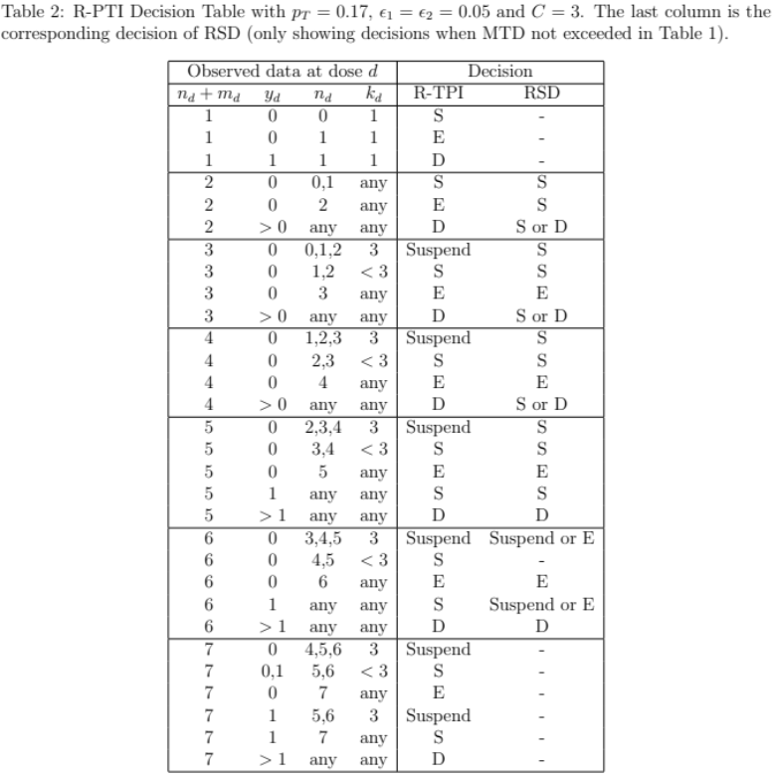
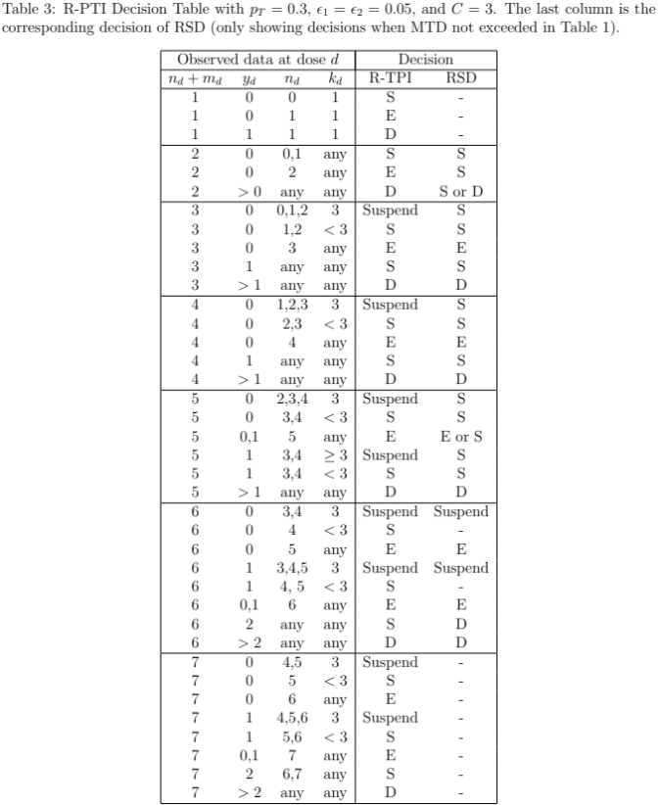
Transparent Decision Table for R-TPI

Slide 16
Transparent Decision Table for R-TPI
Recall the debatable decisions for rolling six:
0 DLT, 0 Non-DLT, 3 pending: S
Somewhat aggressive
0 DLT, 3 Non-DLTs, 1 pending: S
    Waste patient resources at low doses
    In both cases, R-TPI suggests suspension.

Slide 17
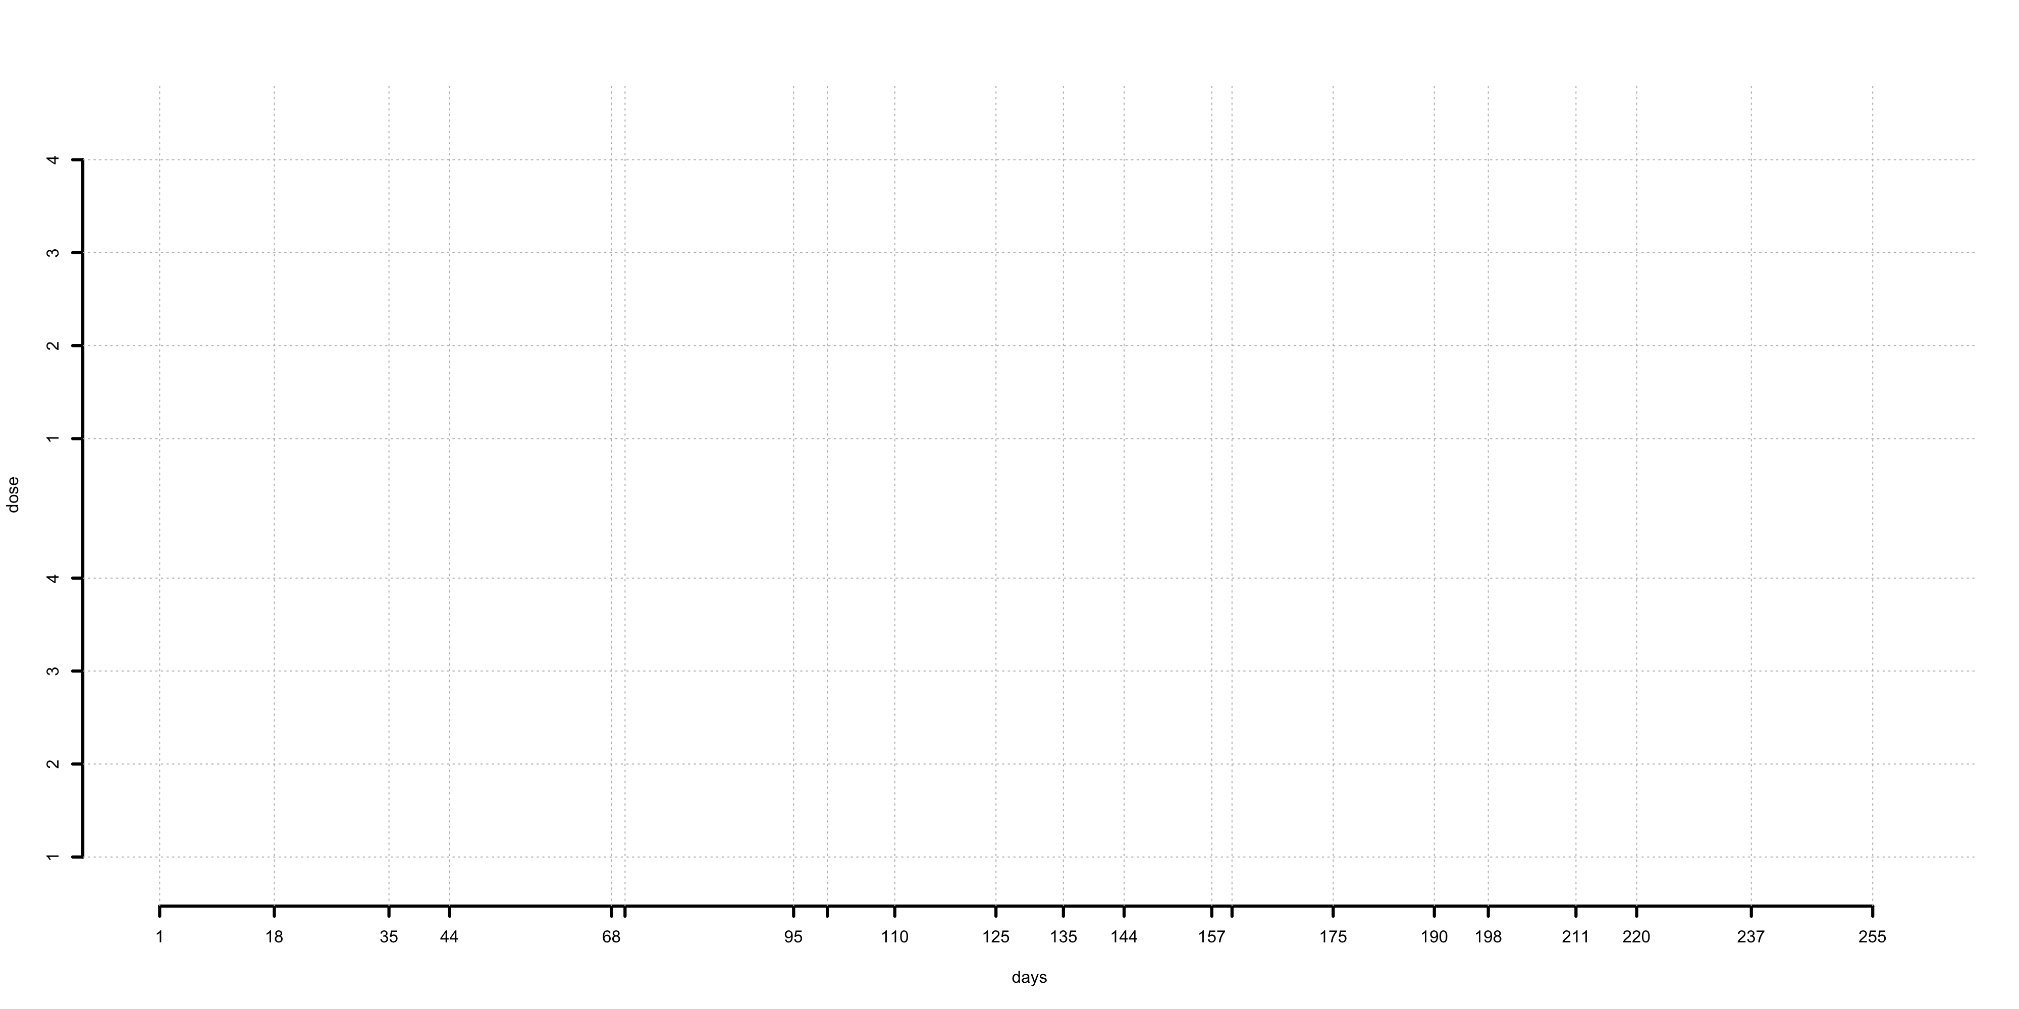
A Simulated Trial for R-TPI (n=15, p_{T}=0.17, DLT follow up window: 21 days )
R-TPI
Speed up
Time-saving
44 days
mTPI-2
₇₀
₁₀₀
₁₆₀
Non-DLT
DLT
Patients turned away

Slide 18
Simulation Studies
We conducted extensive simulation studies
  Simulation studies to compare R-TPI, mTPI-2, 3+3 and Rolling 6 under 60 scenarios under matching sample size of 3+3 with varing
    Target toxicity probabilities
    Number of doses
    Location of true MTD
    Enrollment speed
    C, the maximum number of allowed pending patients

Slide 19
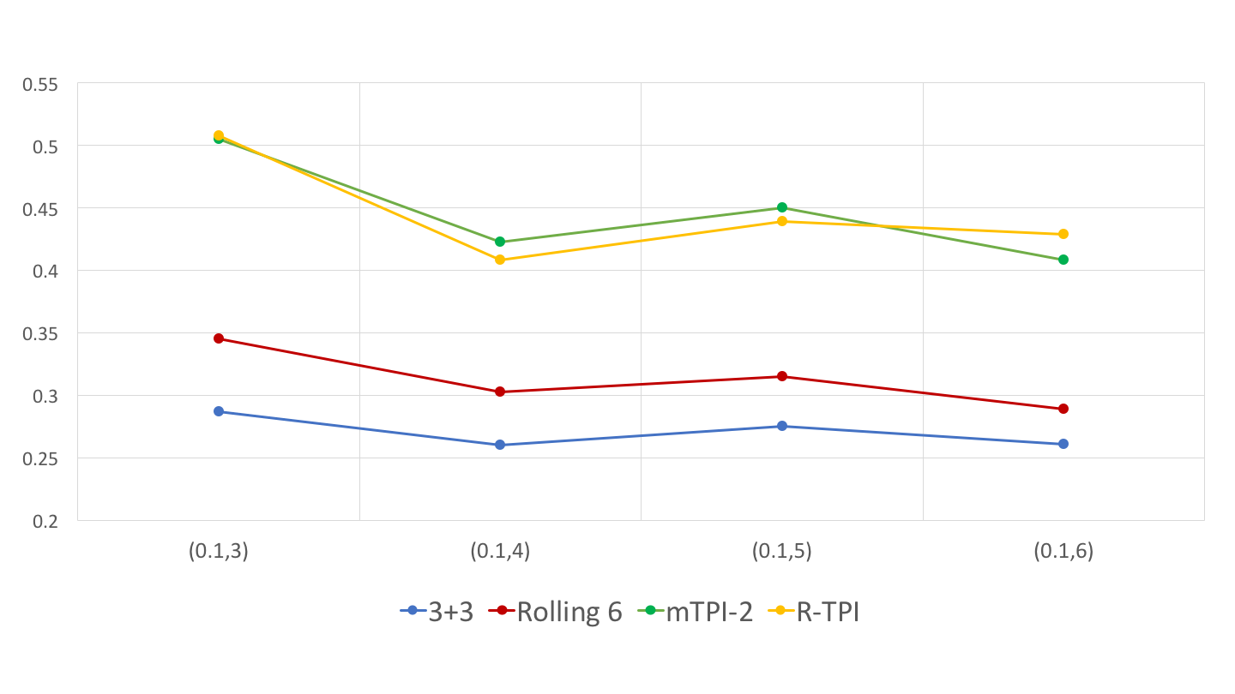
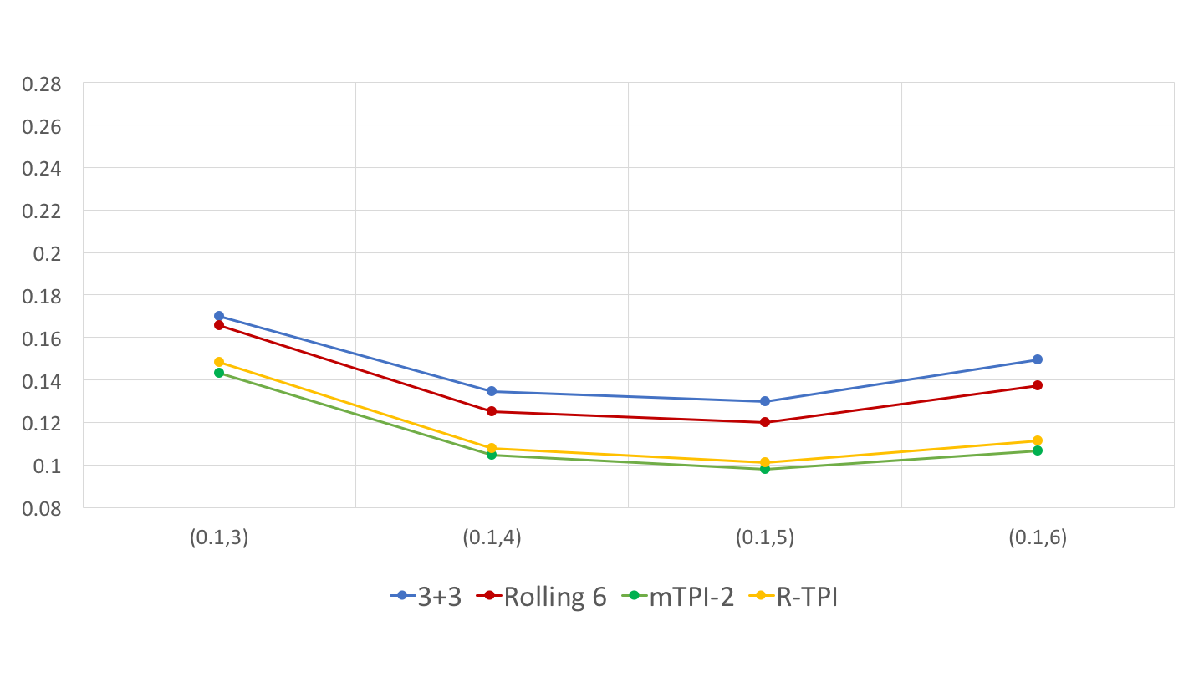
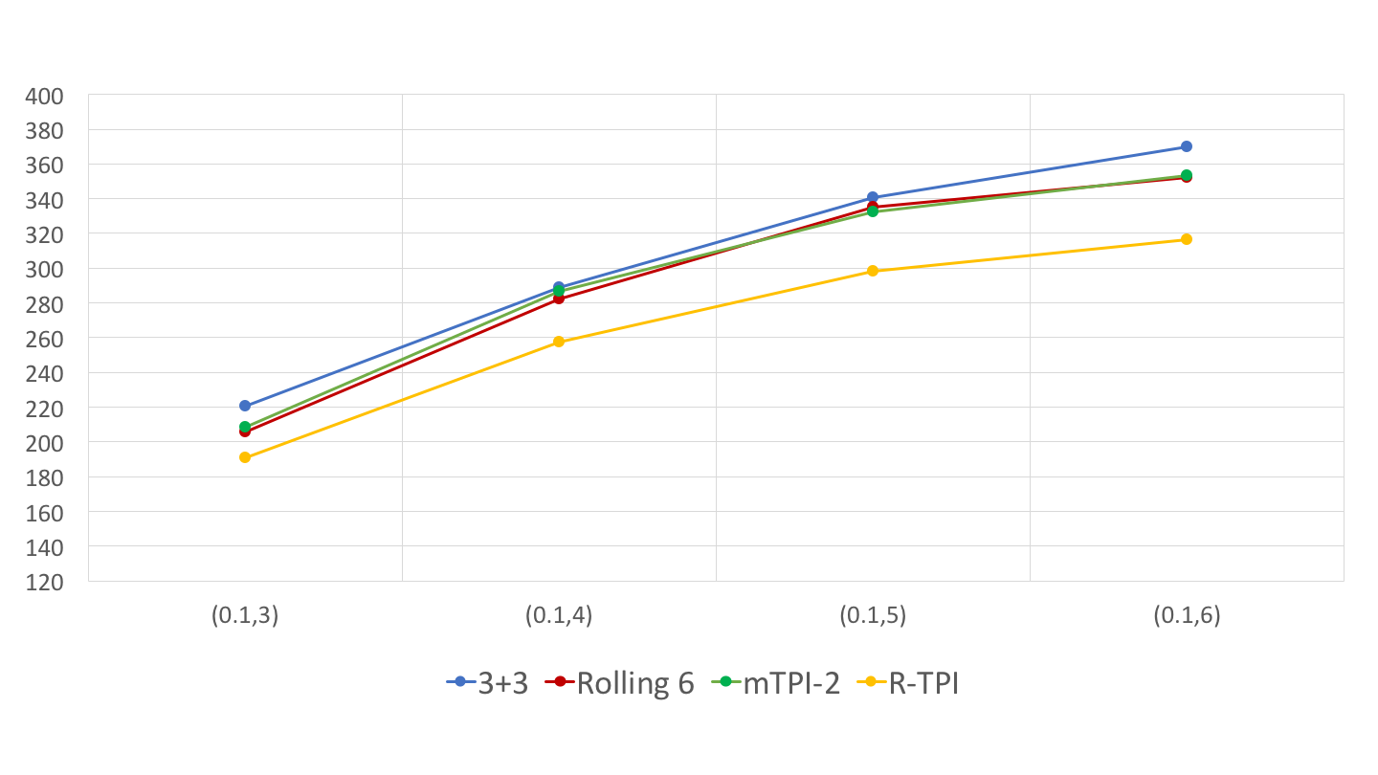
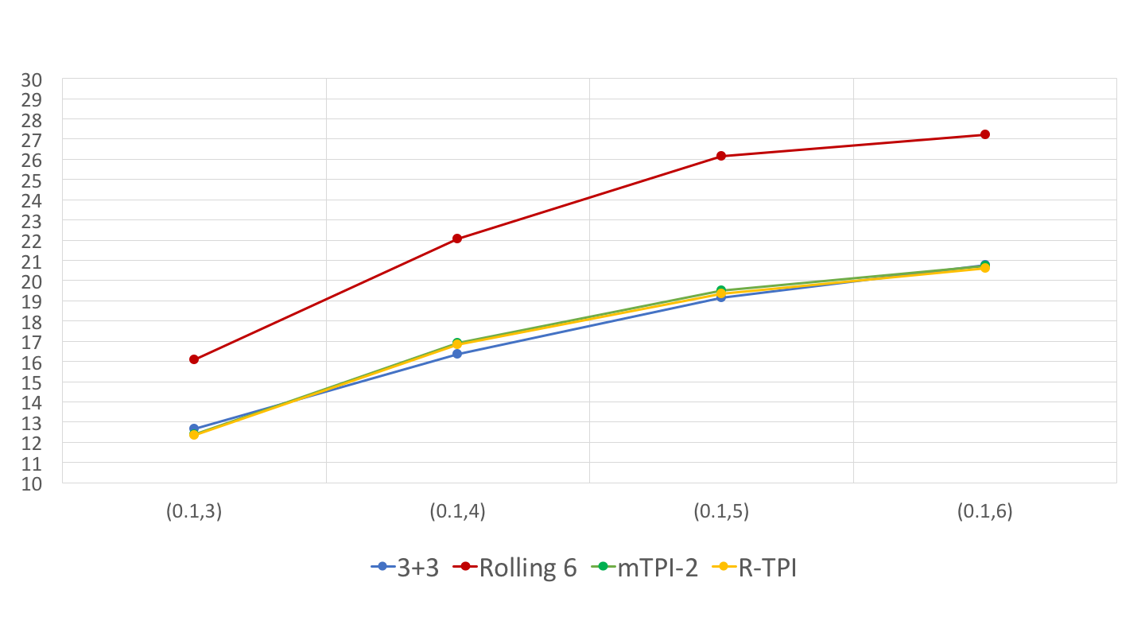
Comparison of Four Designs (pT=0.1, C=3)
Probability of Correct Selection
Probability of Toxicity
Trial Duration
Sample Size

Slide 20
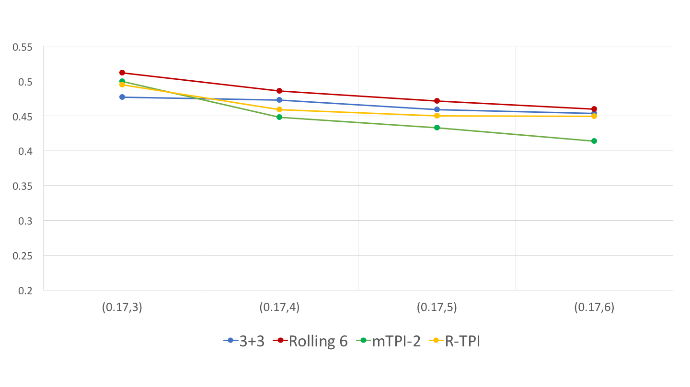
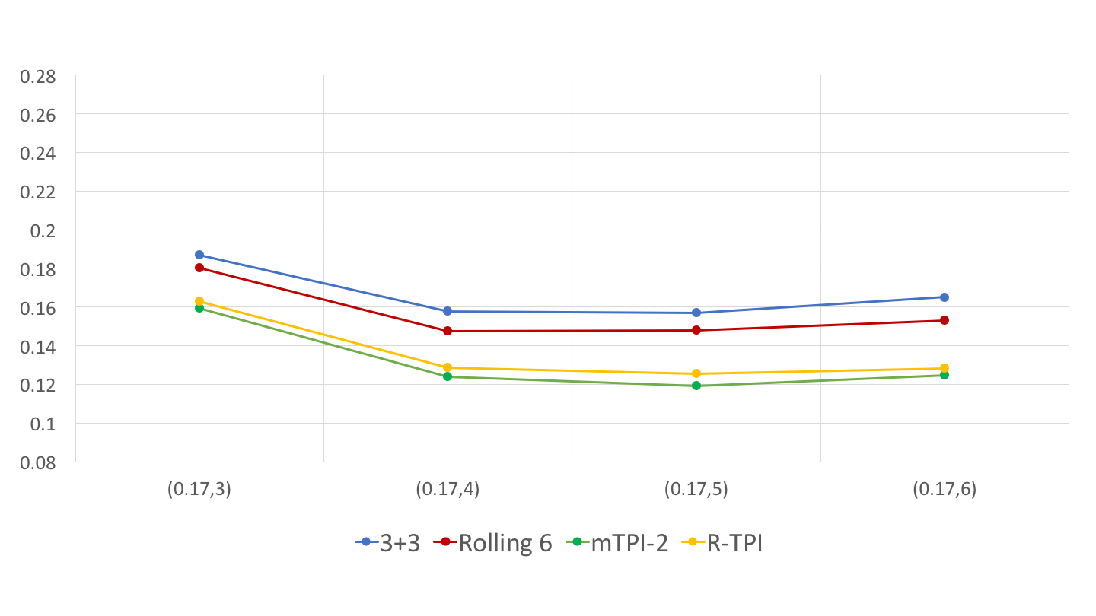
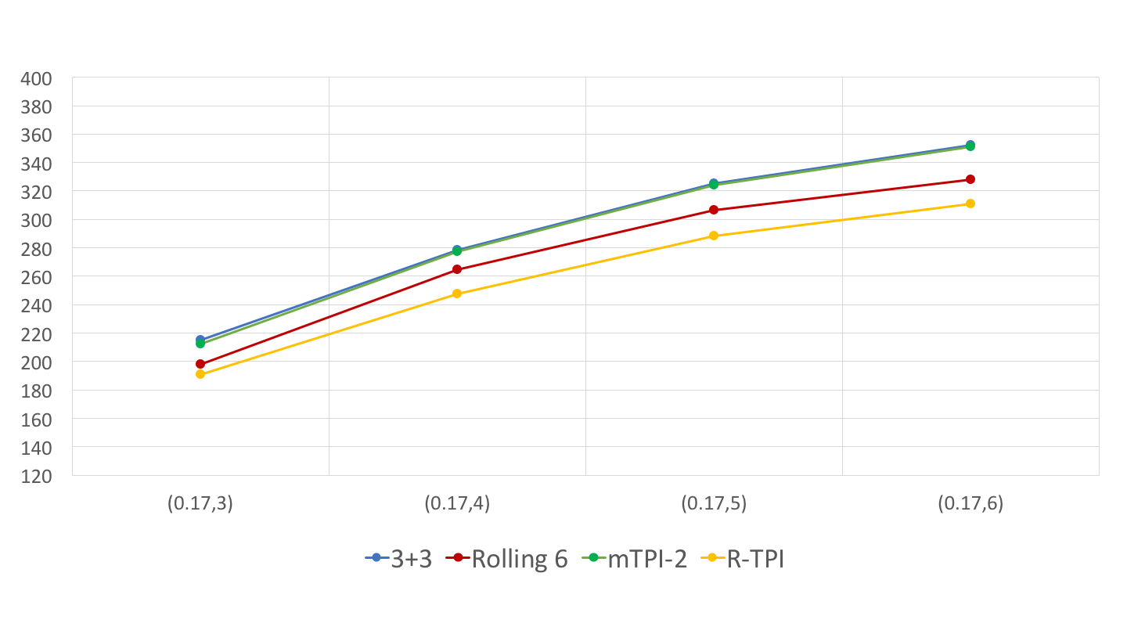
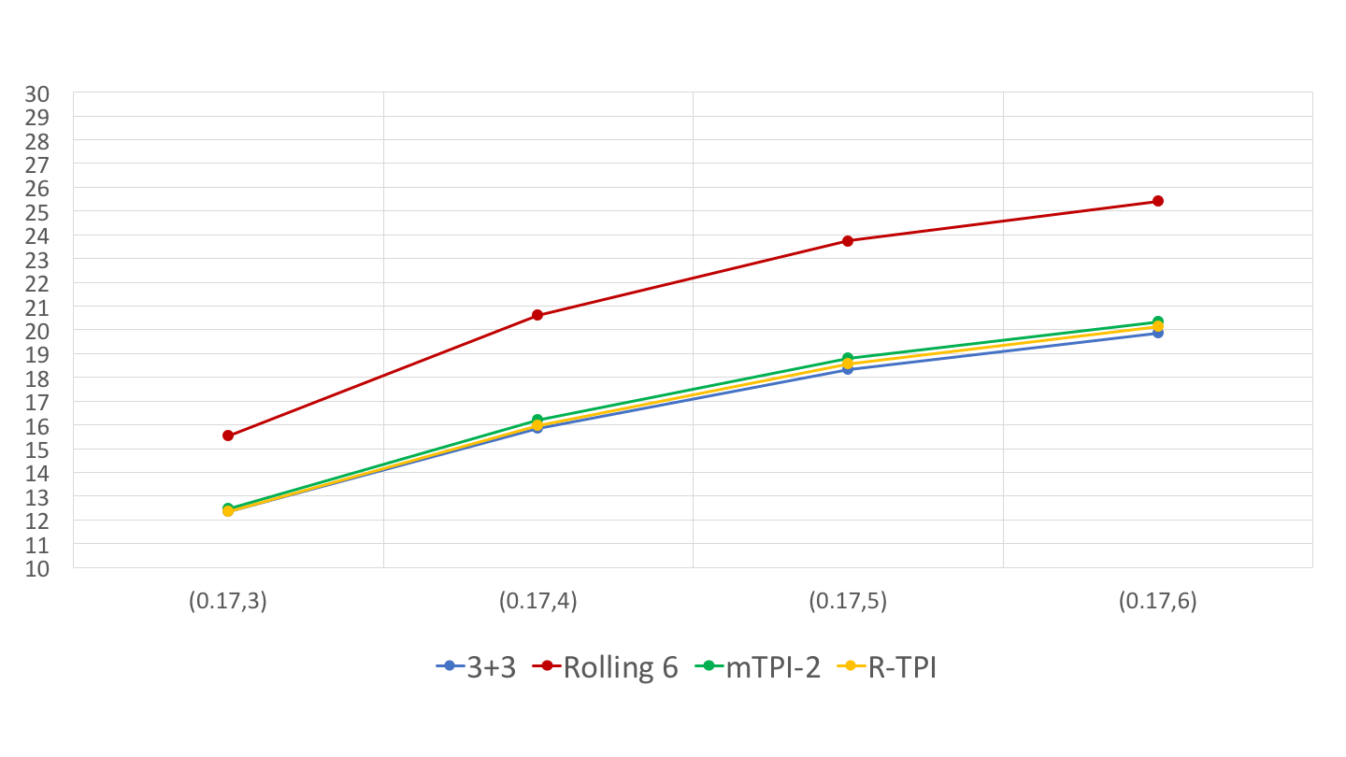
Comparison of Four Designs (pT=0.17, C=3)
Probability of Correct Selection
Probability of Toxicity
Trial Duration
Sample Size

Slide 21
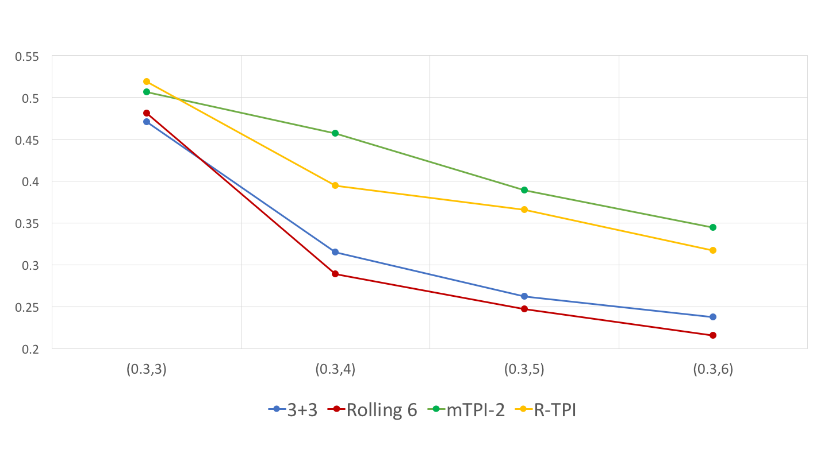
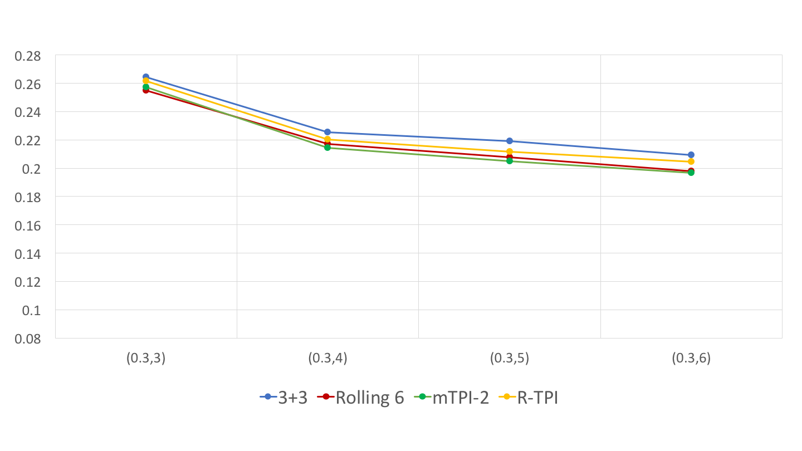
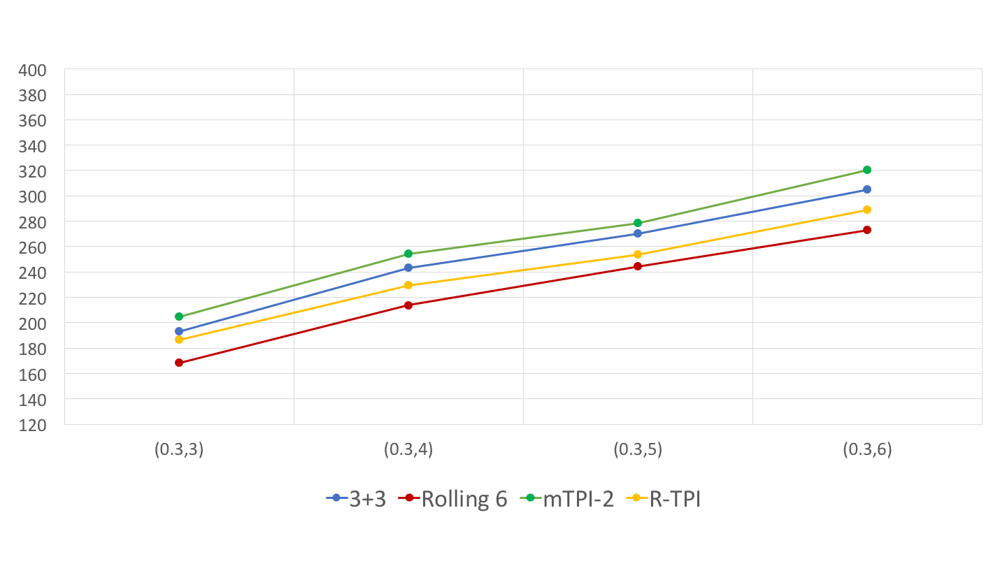
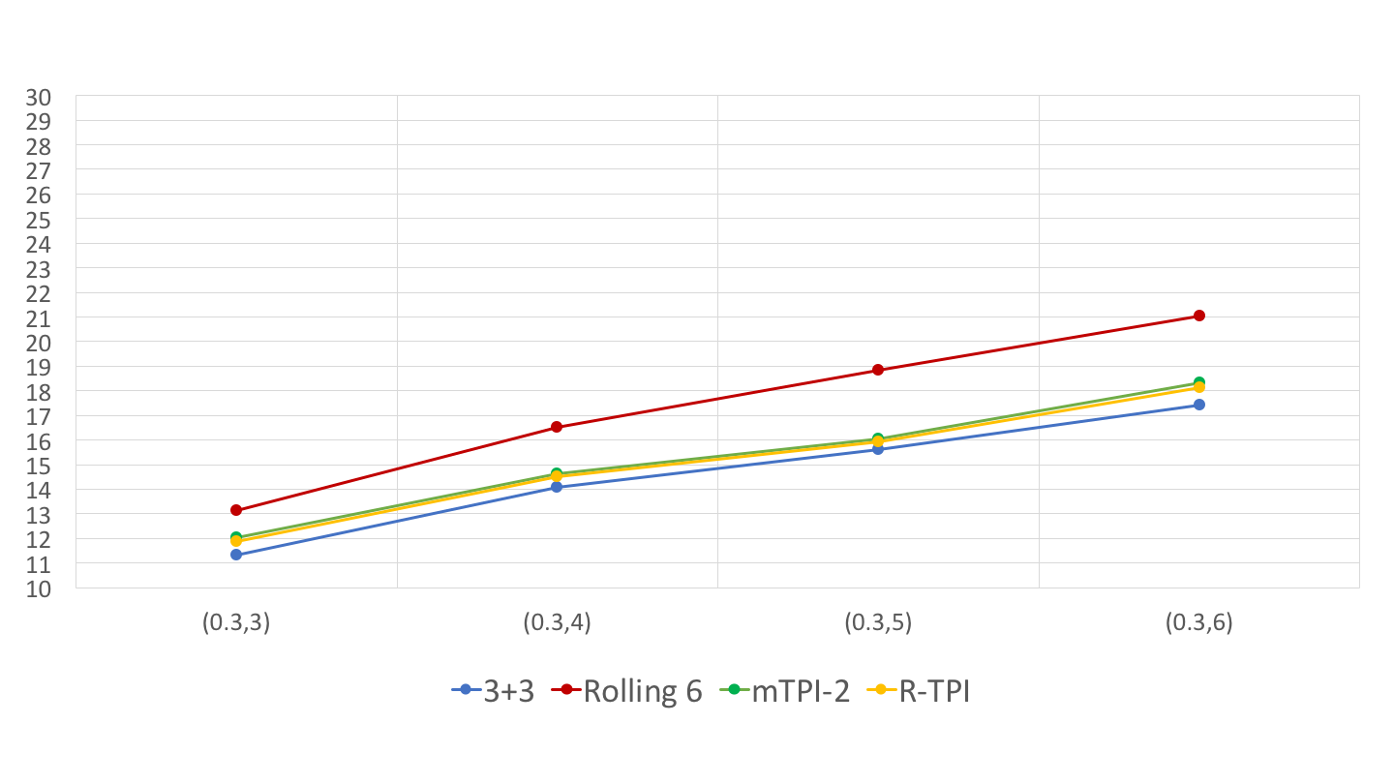
Comparison of Four Designs (pT=0.3, C=3)
Probability of Correct Selection
Probability of Toxicity
Trial Duration
Sample Size

Slide 22
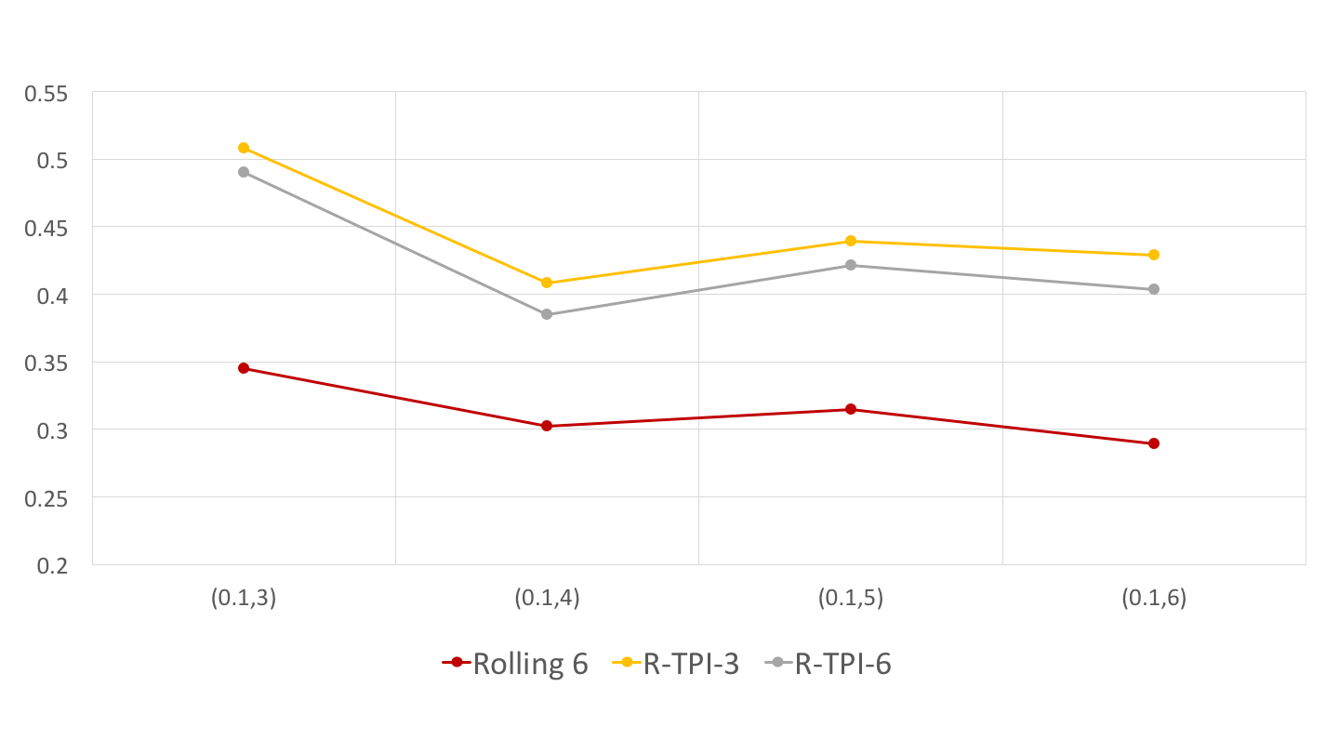
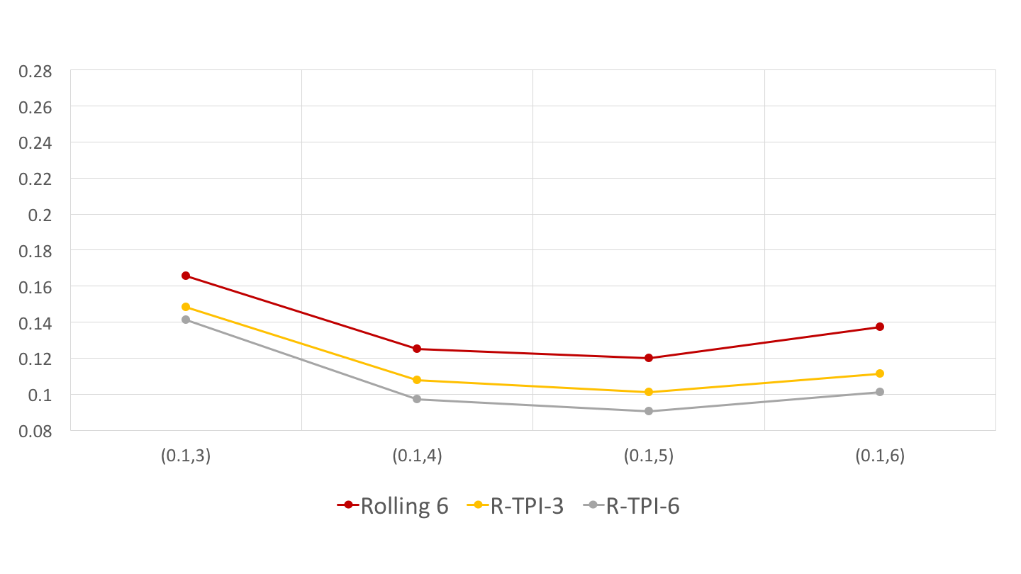
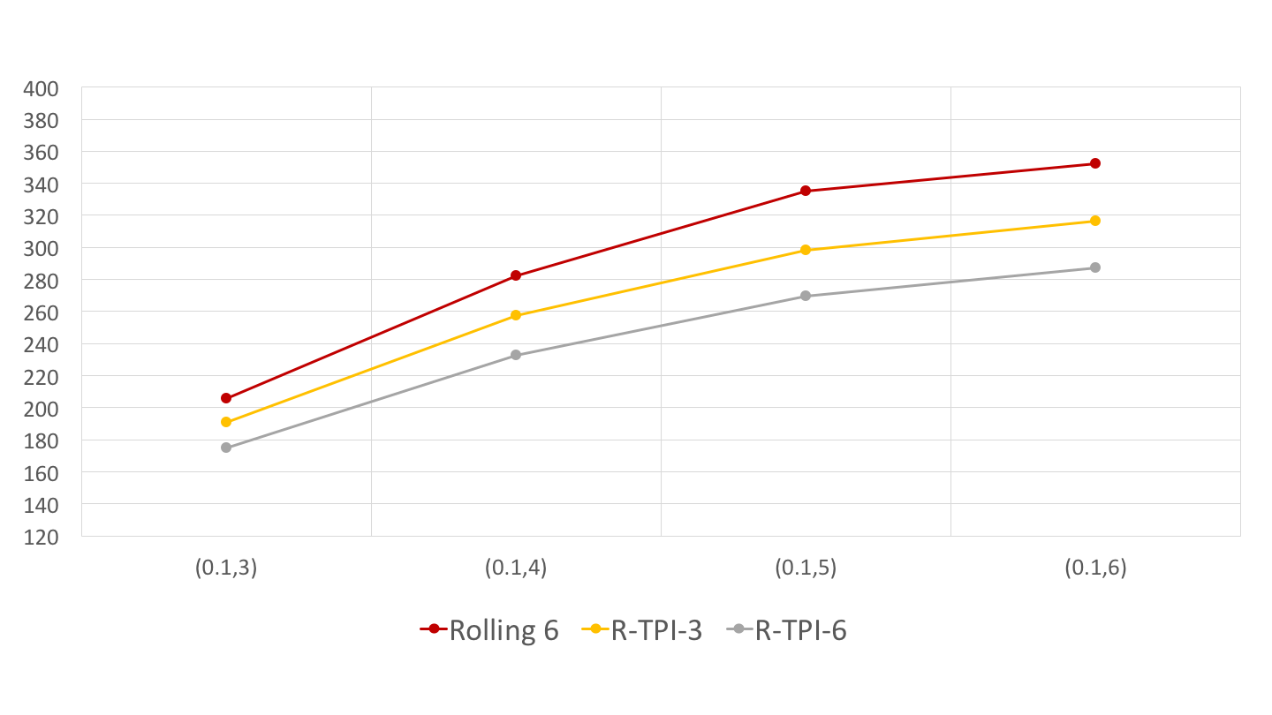
Performance under Different C Values
Probability of Correct Selection
Probability of Toxicity
Trial Duration
R-TPI-3: R-TPI with C=3
R-TPI-6: R-TPI with C=6

Slide 23
Summary and Remarks
In a broad setting involving multiple scenarios, R-TPI is generally faster, safer, and more reliable than 3+3.
R-TPI is faster than mTPI-2, while maintaining the similar toxicity profile and power with mTPI-2.
R-TPI is a simple and transparent design.
RSD tends to enroll too many patients on low doses.
Modeling time to DLT can improve R-TPI.

Slide 24


